Slide 1

Store Management System PREPARED BY:
Abdisa Retta
Ashenafi Chufamo
Fasikaw Kindye
Getachew Tebikew
Hawltu Yenealem
Yared Solomon
July 2019

Slide 2
1.1 Purpose
The purpose of this document is to give a detailed description of the “Store Management” system. It will illustrate the purpose and complete declaration for the development of System, as well as offer a preliminary glimpse of the system application’s User Interface (UI). It will also explain system constraints, interface and interactions with other external applications. This document is primarily intended to be proposed to a customer for its approval and a reference for developing the system for the development team and will be proposed to the project advisors for its approval.

Slide 3
Introduction

Slide 4
Scope
The system is intended to be accessed by all kinds of people including educated, uneducated, labor workers and by other social classes who have basic computer skills. This system is aimed at providing people with an online item ordering.
The system has two web based software products; one for the administrator of the store, and the other is for the customers.

Slide 5
Requirements

Slide 6
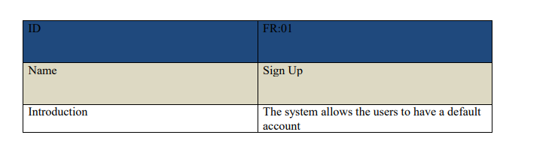
Functional requirement

Slide 7
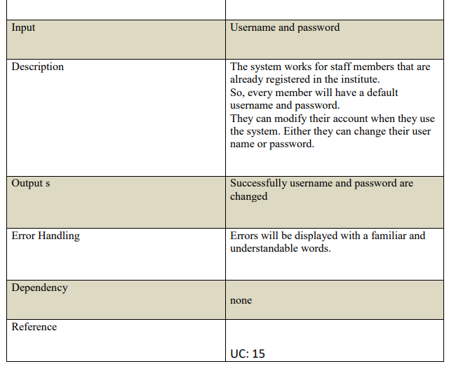

Slide 8
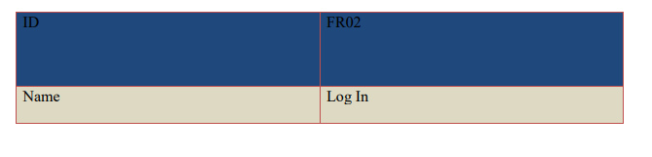
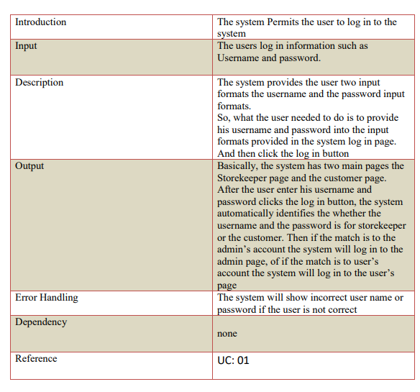

Slide 9
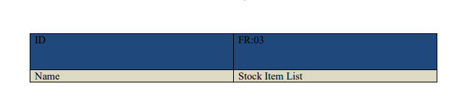
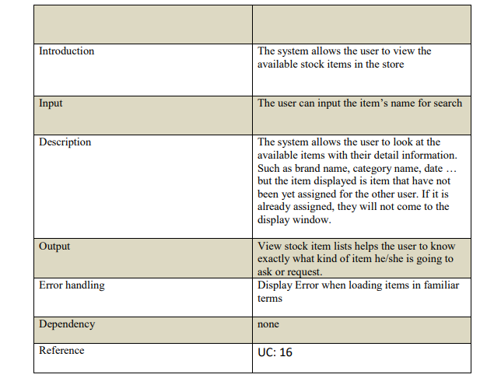

Slide 10
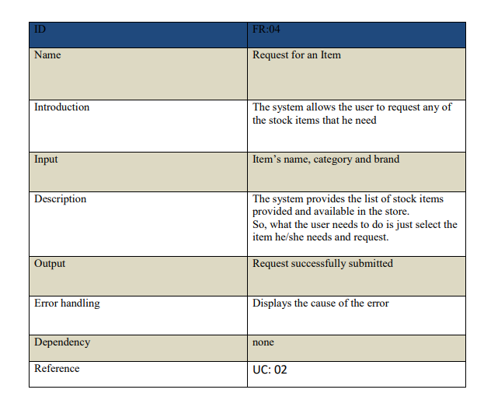

Slide 11
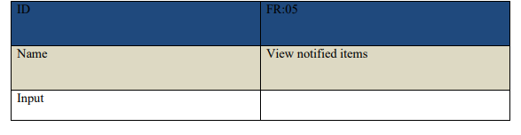
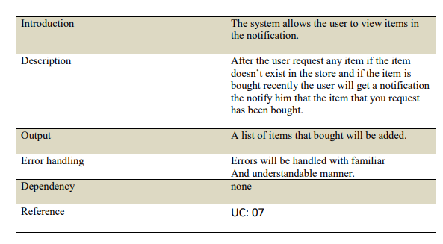

Slide 12
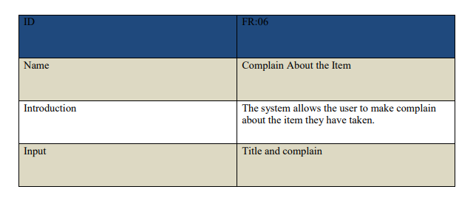
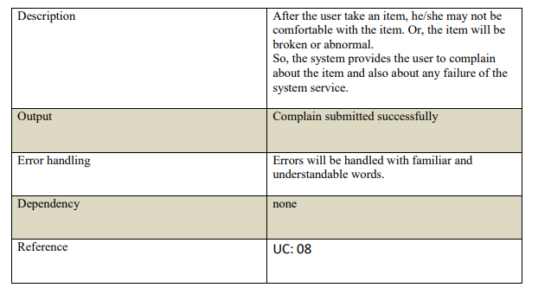

Slide 13
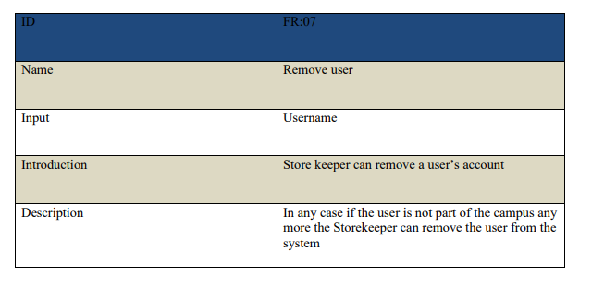
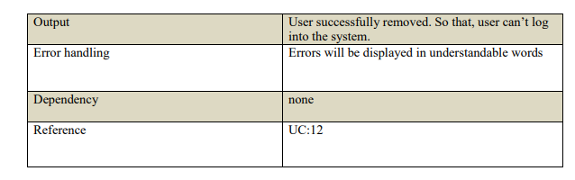

Slide 14
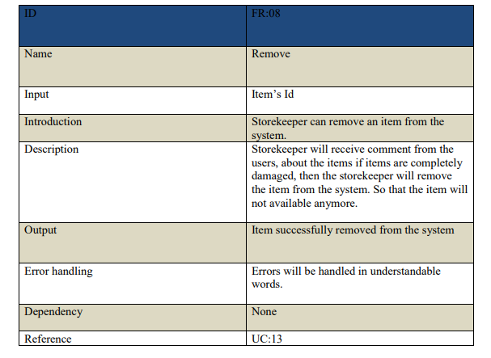

Slide 15
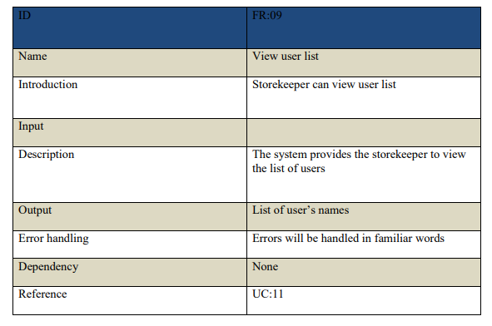

Slide 16
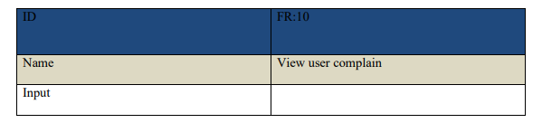
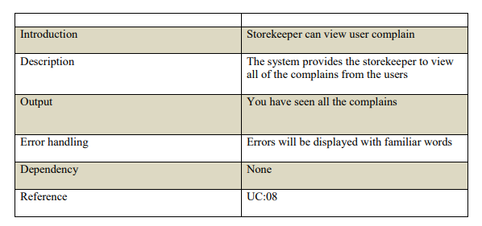

Slide 17
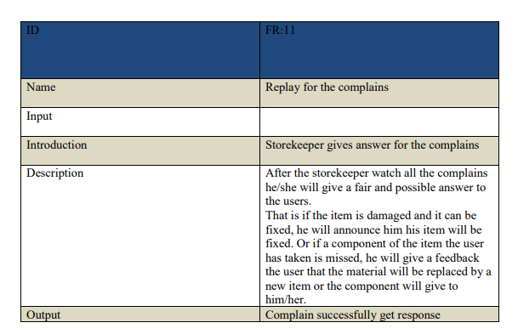
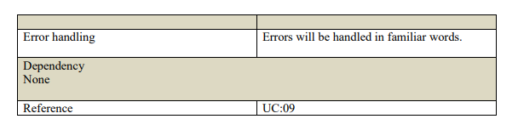

Slide 18
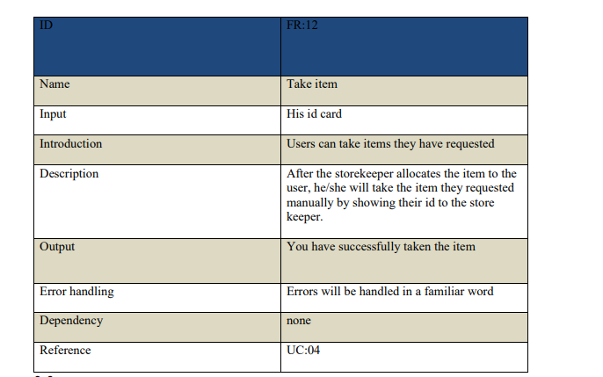

Slide 19
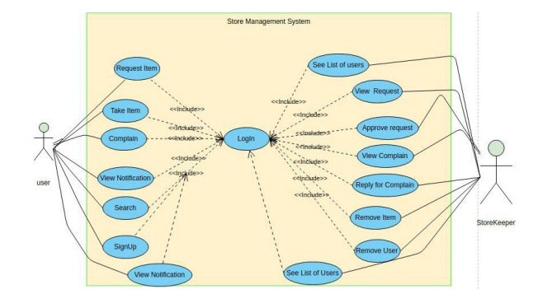
USE CASE

Slide 20
Non-Functional requirement
Performance:- The system designed to operate given task in short period of time. The system provide service for many user at once to work with many customers. The system provides the required services in a short period of time.
Reliability:-The system backup it’s database in two day ‘s gap constantly in case of failure happens, if failure happens the system restore to its normal condition using backup data.
Availability:- The system work twenty-four hours a day, seven days a week to satisfy users need. The system available on web and android phone to increase accessibility of the system.
Security:- The users and hotel managers personal information is confidential. The system gives high protection for money transactions, thus helps to pay for orders.
Maintainability:- The system designed to support flexibility and extension which helps to maintain easily and efficiently.
Portability:- The system is expected to be compatible with all web browsers and devices of various specifications

Slide 21
Class Diagram and Sequence diagram

Slide 22
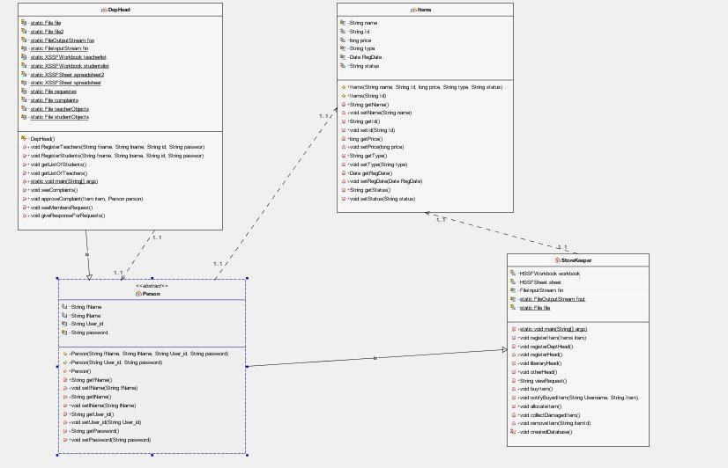

Slide 23
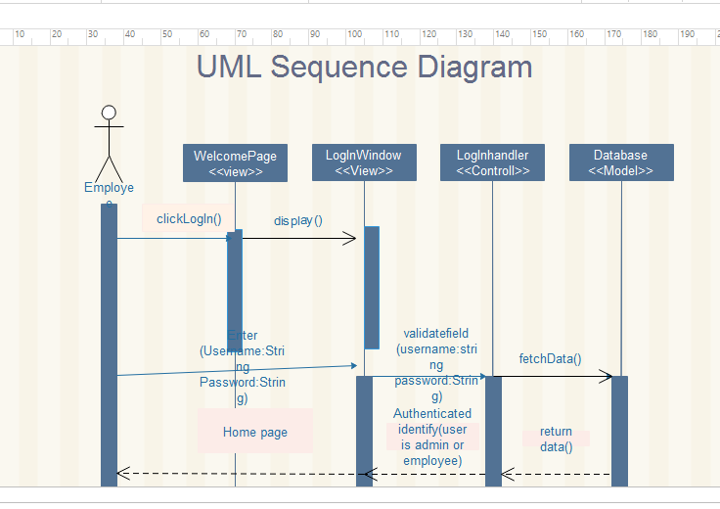
Login

Slide 24
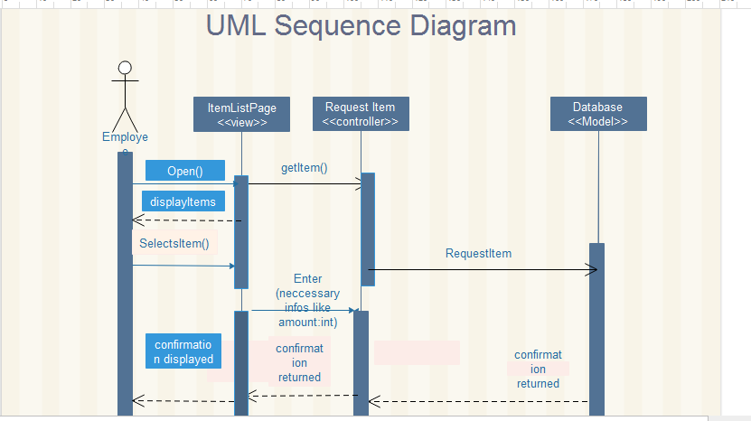
requesting item

Slide 25
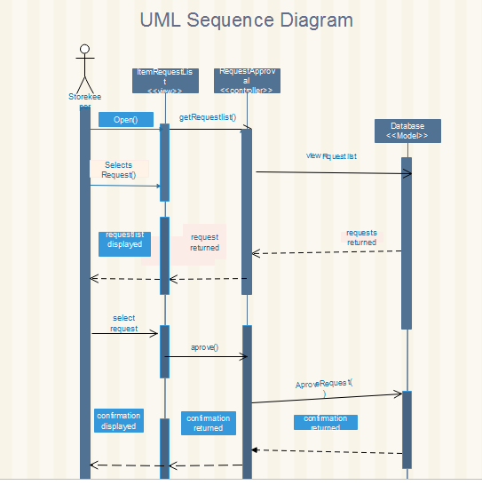
Approval request

Slide 26
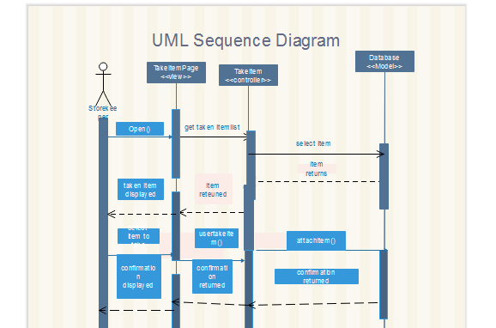
Take an item

Slide 27
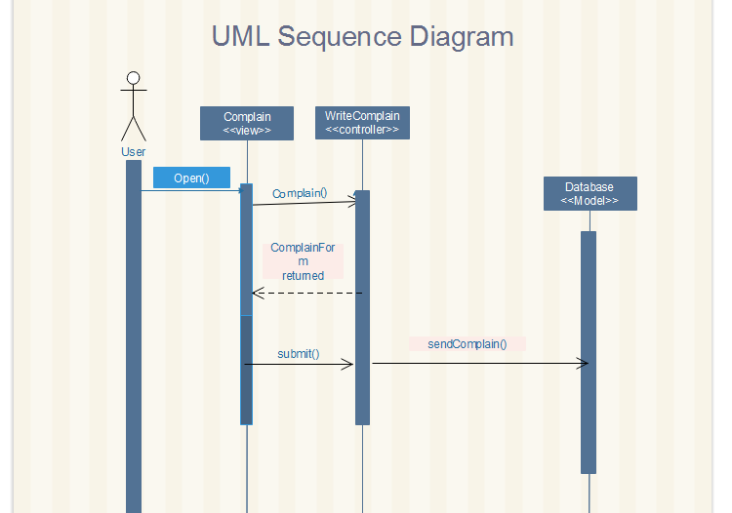
complain

Slide 28
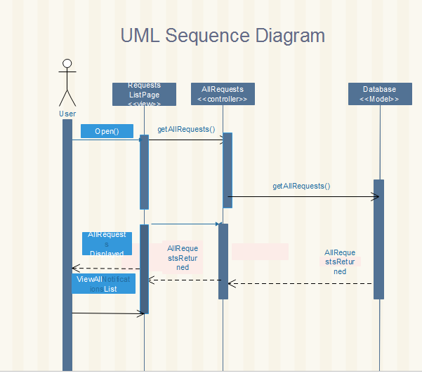
View request

Slide 29
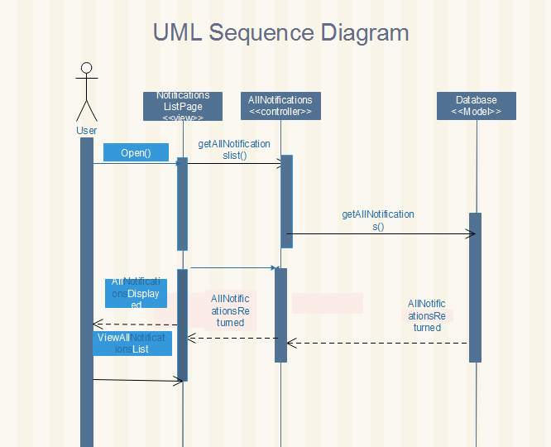
View Notification

Slide 30
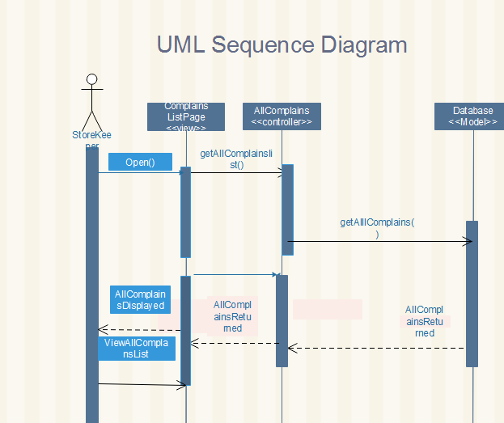
View complain

Slide 31
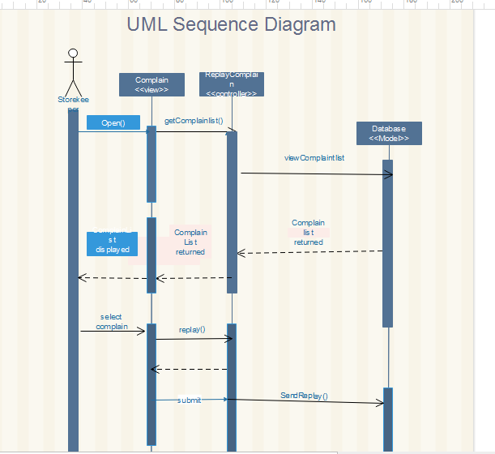
Replay for complain

Slide 32
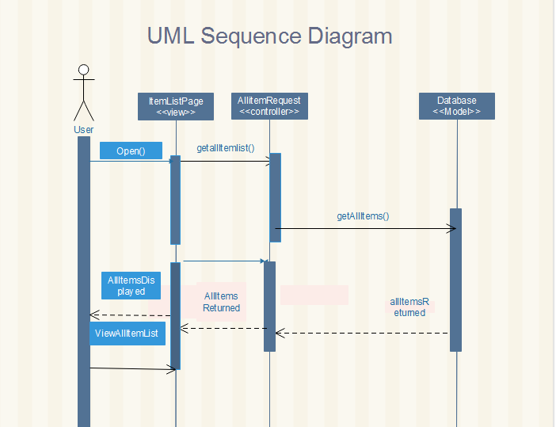
View List of item

Slide 33
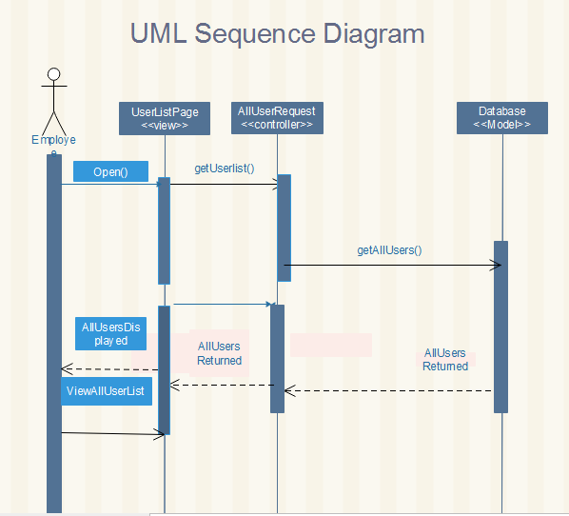
View list of users

Slide 34
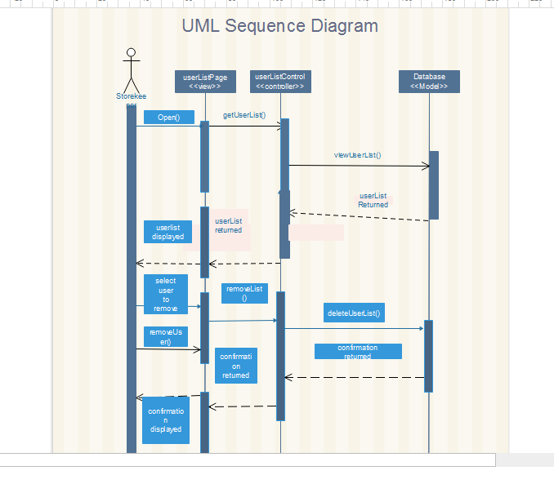
Remove user

Slide 35
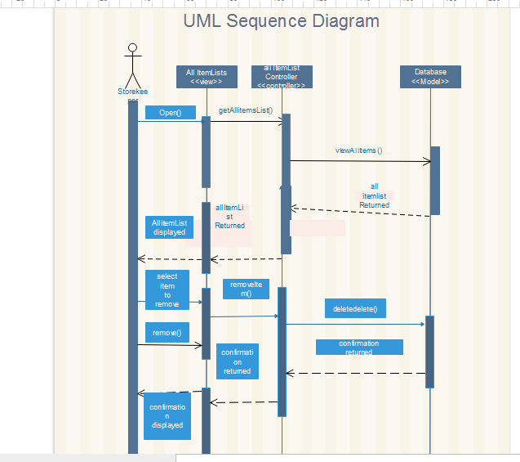
Remove item

Slide 36
Component and Deployment Diagrams

Slide 37
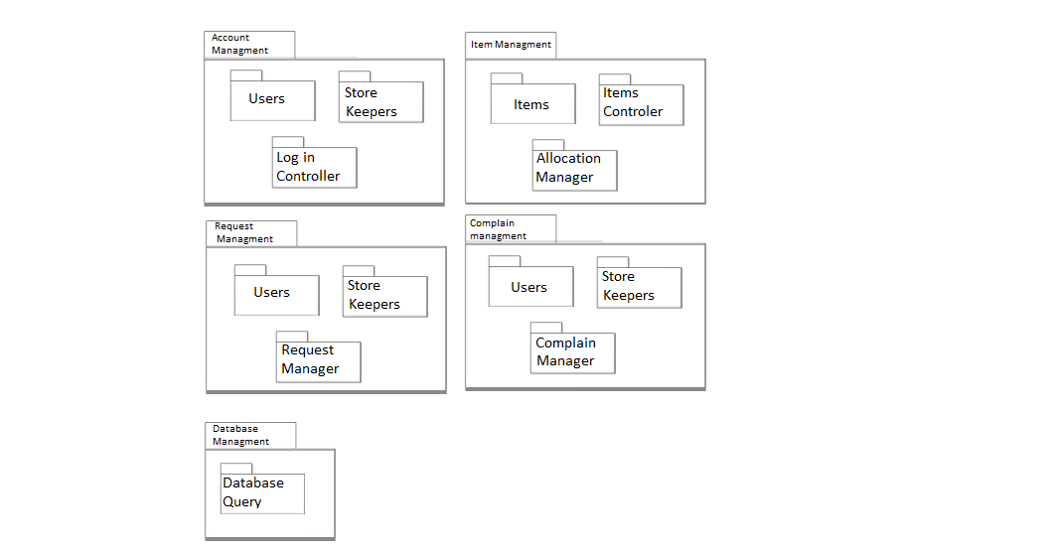
Component diagram one

Slide 38
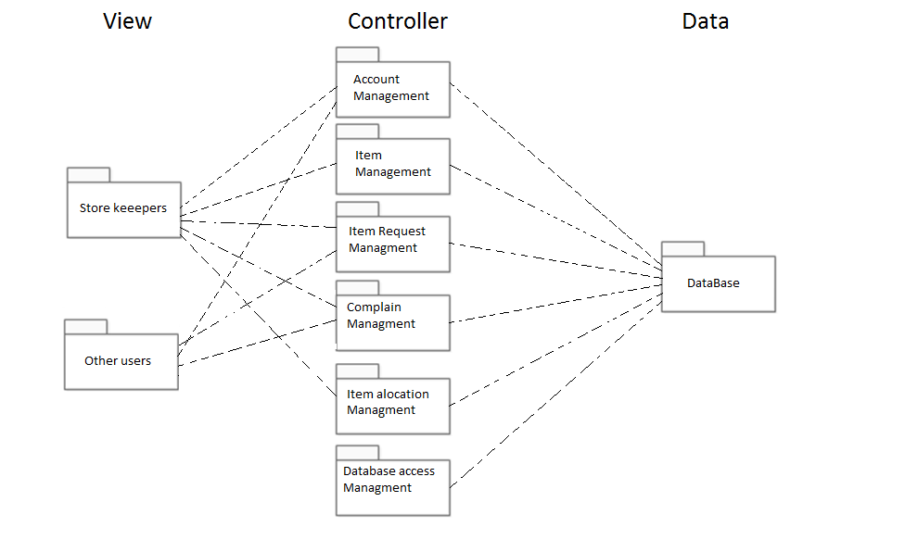
Component diagram two

Slide 39
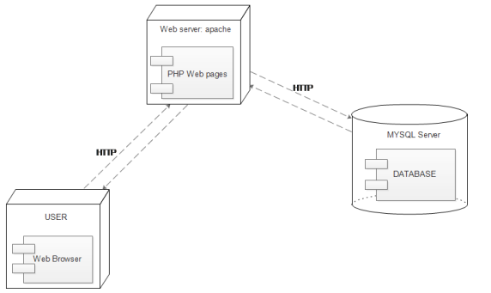
UML Deployment Diagram

Slide 40
Implementation

Slide 41
Storekeeper
username:atr/8587/10 password:1234

Slide 42
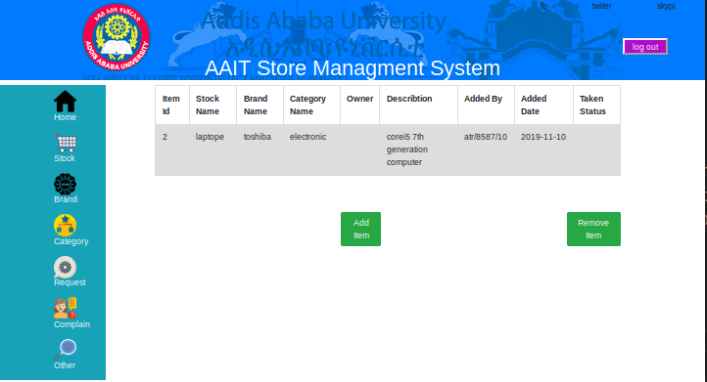
Stock

Slide 43
This is the window by which storekeepers checks any relevant information about the items both in stock and taken.
There are Two main functions implemented here, ADD and REMOVE.
The ADD button is used to add new items to the list while the REMOVE button is used to delete the item from list.

Slide 44
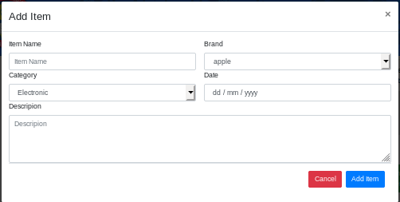
Add New Item

Slide 45
This is the window used to add new items to stock.
You need to give name to the stock, choose the category and brand form the dropdown list, and finally give some discription about the item then click ADD ITEM.
You can also click on the CANCEL button to go back to stock screen.

Slide 46
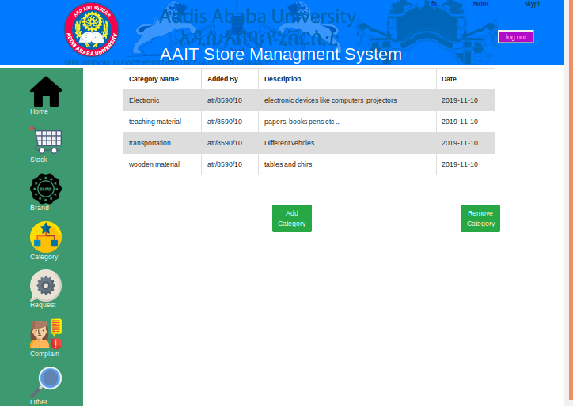
Category

Slide 47
This is the window by which storekeepers add and remove category information.
Category shows what the object Is made for.
It has a name, date added, some description and the person who added.

Slide 48
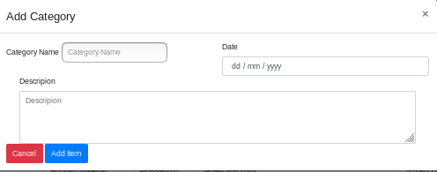
Add New Category

Slide 49
This is the window used to add new items to stock.
You need to give name to the category, give date and finally give some description about the item then click ADD ITEM
You can also click on the CANCEL button to go back to stock screen.

Slide 50
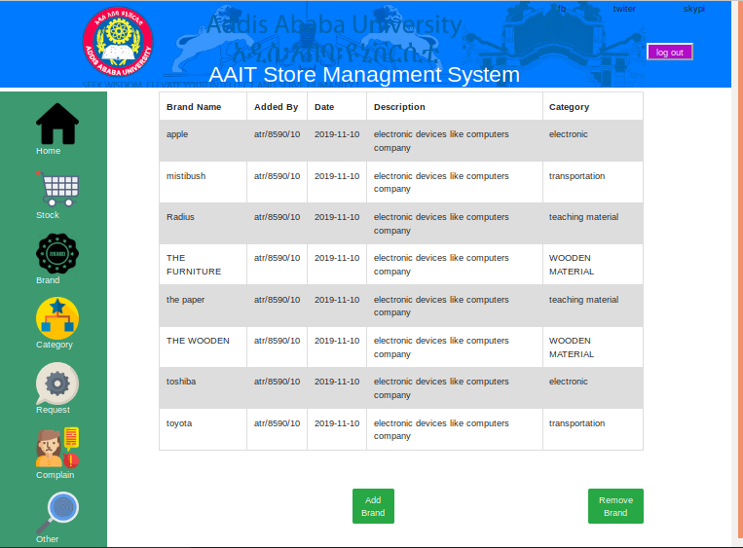
Brand

Slide 51
This is the window by which storekeepers add and remove Brand information.
Brand shows who made the object.
It has a name, date added, some description, category and the person who added.

Slide 52
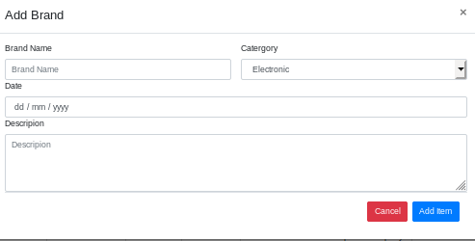
Add New Brand

Slide 53
This is the window used to add new Brands.
You need to give name to the brand, choose the category form the dropdown list, and finally give some description about the item then click ADD ITEM.
You can also click on the CANCEL button to go back to stock screen.

Slide 54
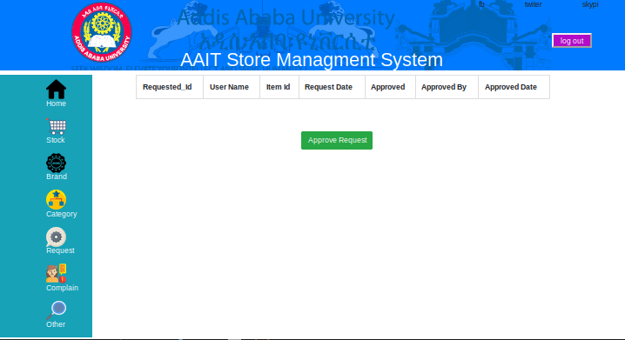
Request

Slide 55
This is the window by which storekeepers approves and denies Item Requests.
It has a request id, user name, date requested, item id, approved by and approved.

Slide 56
Normal User
Username:atr/8584/10
Password: 1234

Slide 57
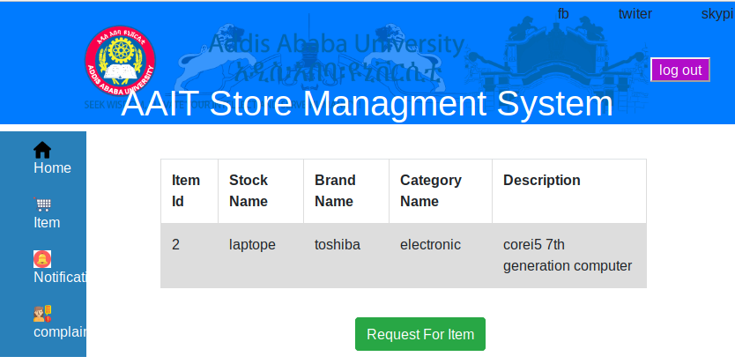
User Item

Slide 58
This is the window used to check out Items in List and take request for an item.
You need to give name to the brand, choose the category form the dropdown list, and finally give some description about the item then click ADD ITEM.
You can also click on the CANCEL button to go back to stock screen.

Slide 59
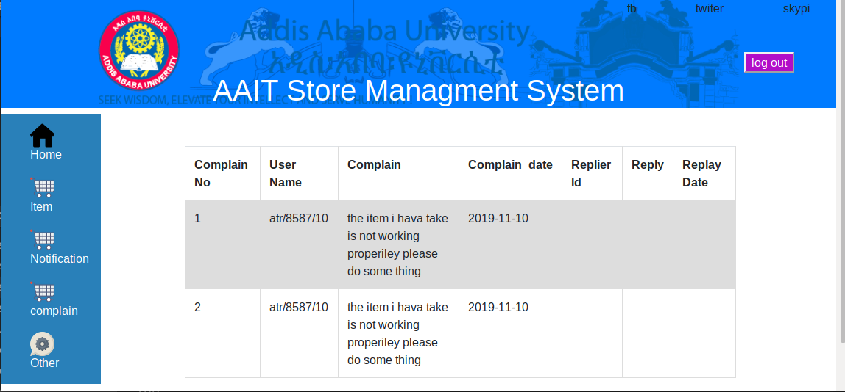
User Complain

Slide 60
This is the window used to complain about the product inhand.
You need to give name to the brand, choose the category form the dropdown list, and finally give some description about the item then click ADD ITEM.
You can also click on the CANCEL button to go back to stock screen.

